Slide 1
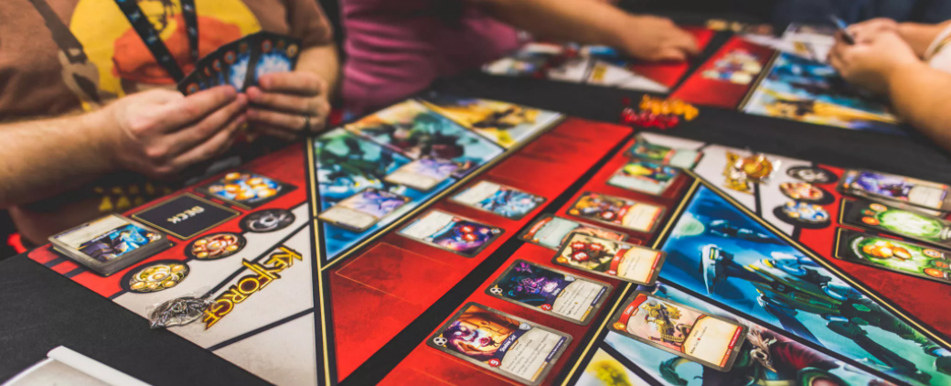

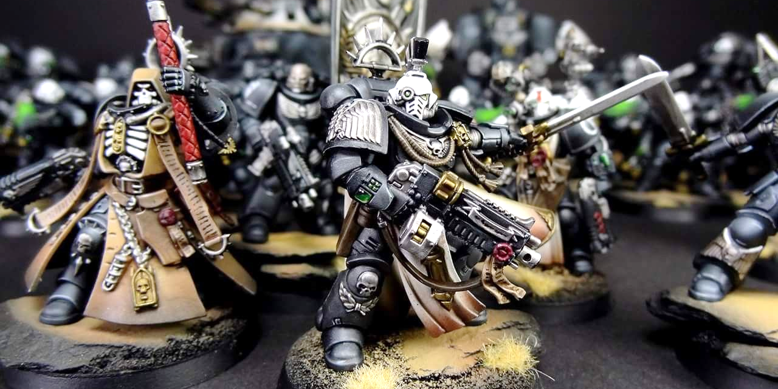
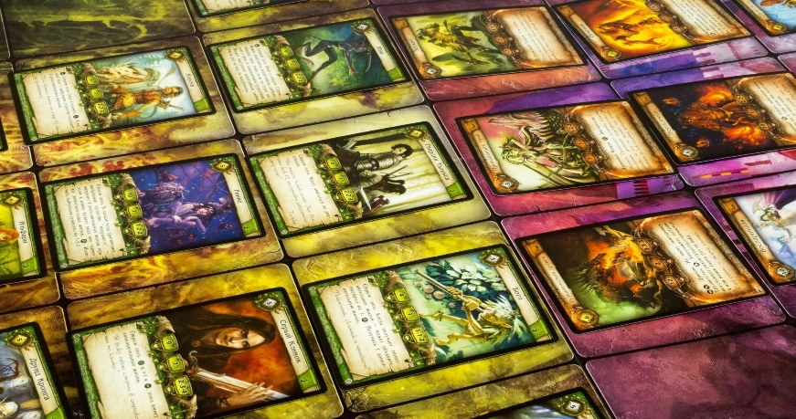
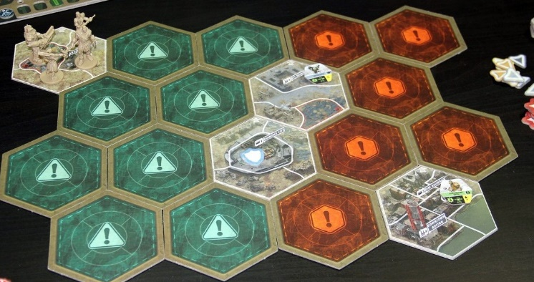
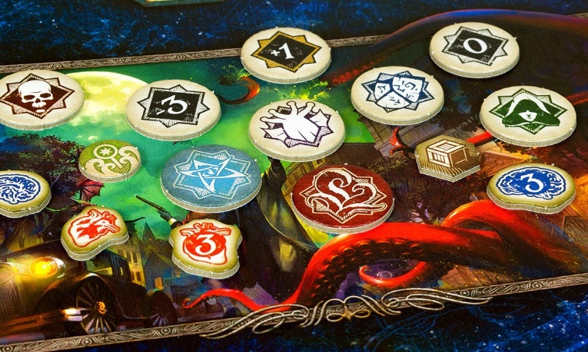
HOBBY WORLD
PUBLISHER THAT HAS CHANGED THE WORLD OF RUSSIAN BOARD GAMES

Slide 2
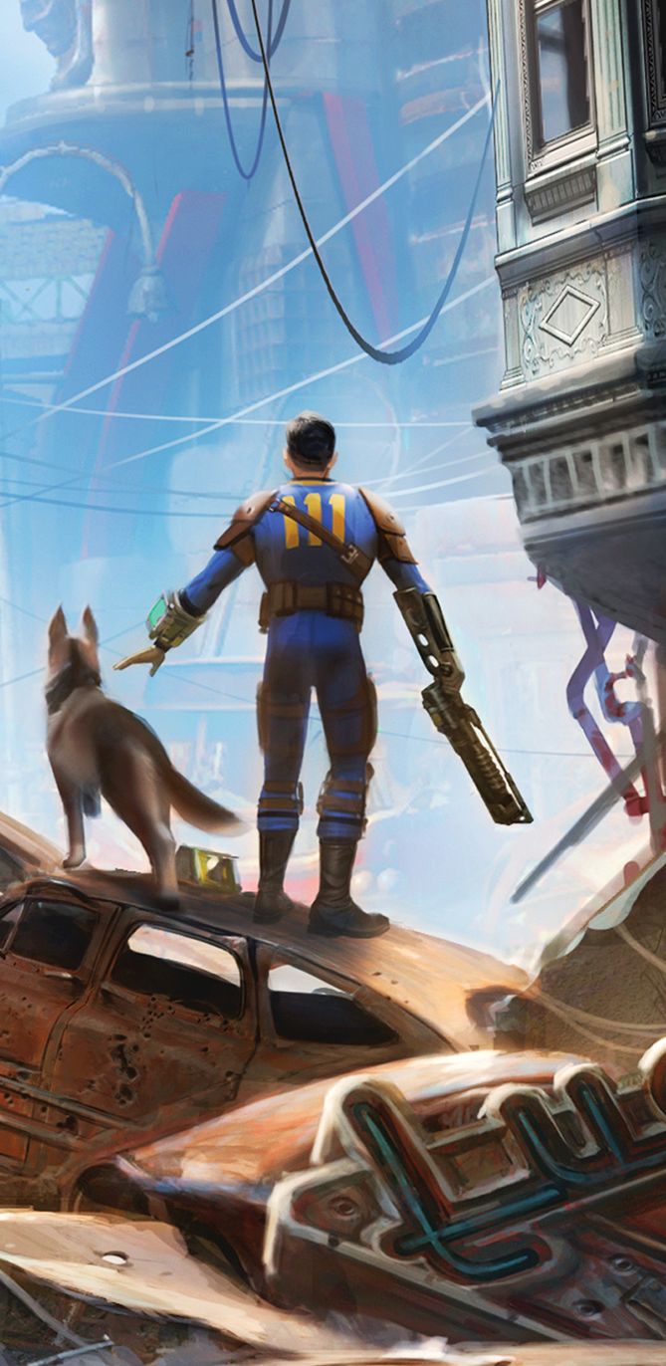
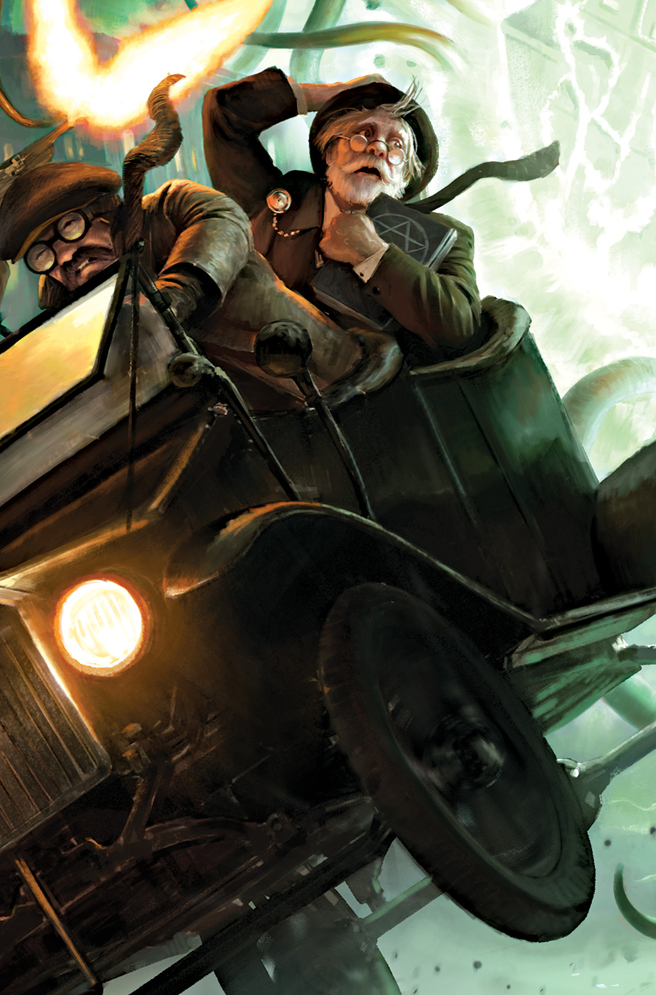
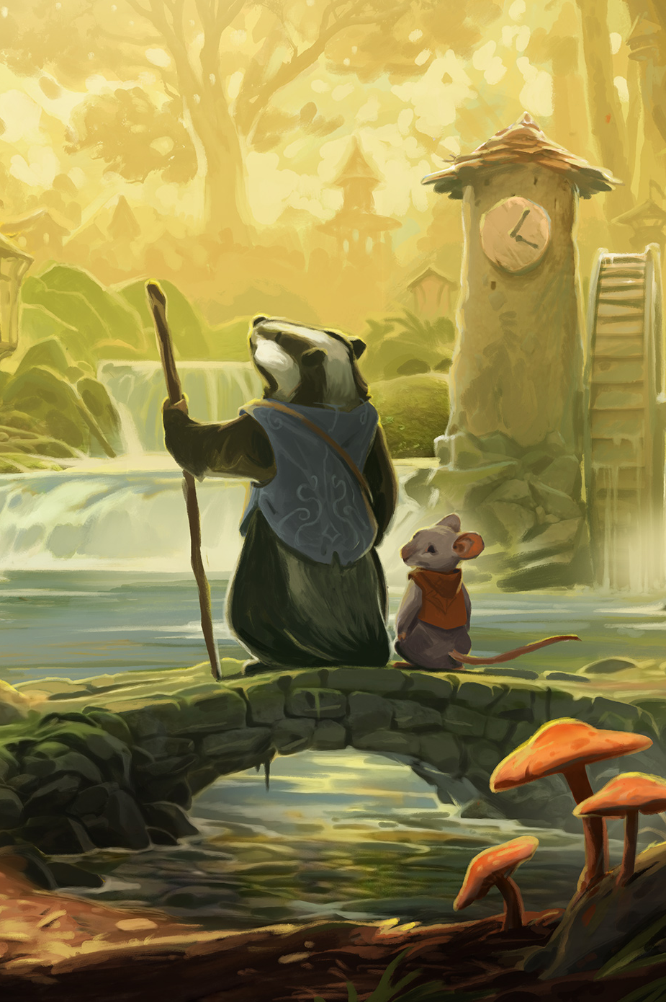
publishing
holding
№ 1
HOBBY WORLD is the largest publishing house and distributor of board games and accessories in Russia that is working together with the world leading manufacturing companies.
IN RUSSIA AND CIS by board games sales volume
CHILDREN’S AND FAMILY GAMES
PARTY GAMES
STRATEGIC GAMES
BOARD GAMES PUBLISHER
RETAIL STORES ALL OVER RUSSIA
CONVENTIONS FOR BOARD GAME LOVERS AND GEEKS
COLLECTIBLE CARD GAMES
WARGAMES
Development and production of our own projects and localization of world-known bestsellers for Russian and global market
More than 200 retail stores under Hobby Games and Mosigra brands all over Russia and CIS where more than 7 thousand products are presented
An annual convention called Igrocon is held by our holding where more than 40 thousand board game fans are brought together
ECONOMIC GAMES
DETECTIVE GAMES
2

Slide 3

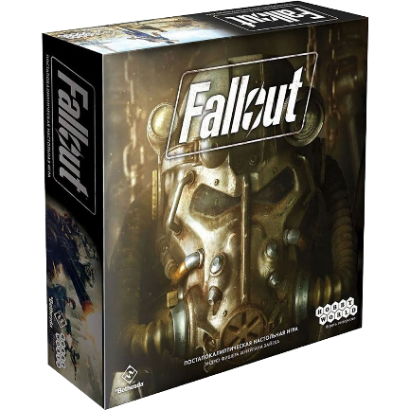
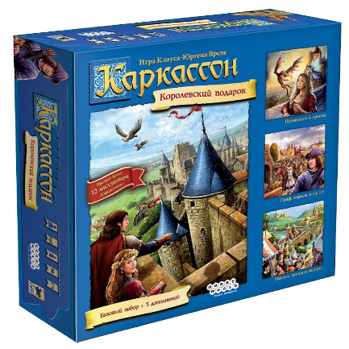
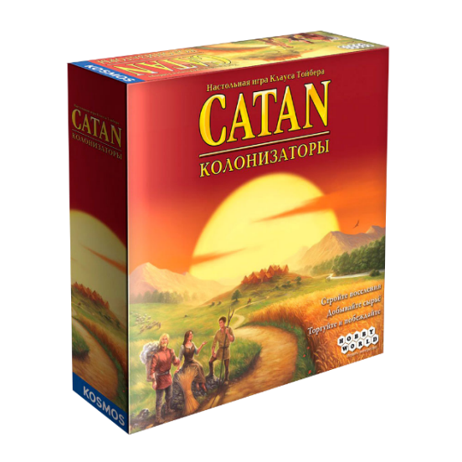

Hobby World
3 MLN
120+
in numbers
COPIES
BOARD GAMES
OF BOARD GAMES ARE MANUFACTURED
AT OUR OWN FACILITIES
WITH A COMPLETE
PRODUCTION CYCLE
OF OUR OWN DEVELOPMENT
WE ARE IN TOP-20 LARGEST GLOBAL COMPANIES PUBLISHING BOARD GAMES.
4000+
900+
STORES
BOARD GAMES
WHERE OUR HOLDING’S PRODUCTS ARE PRESENTED
HAVE BEEN LOCALIZED AND PUBLISHED UNDER HOBBY WORLD
BRAND NAME
50+
100+
GAMES
NEW GAMES
HAVE BEEN RELEASED ON THE INTERNATIONAL MARKET IN 27 LANGUAGES
ARE PUBLISHED
EACH YEAR
3

Slide 4
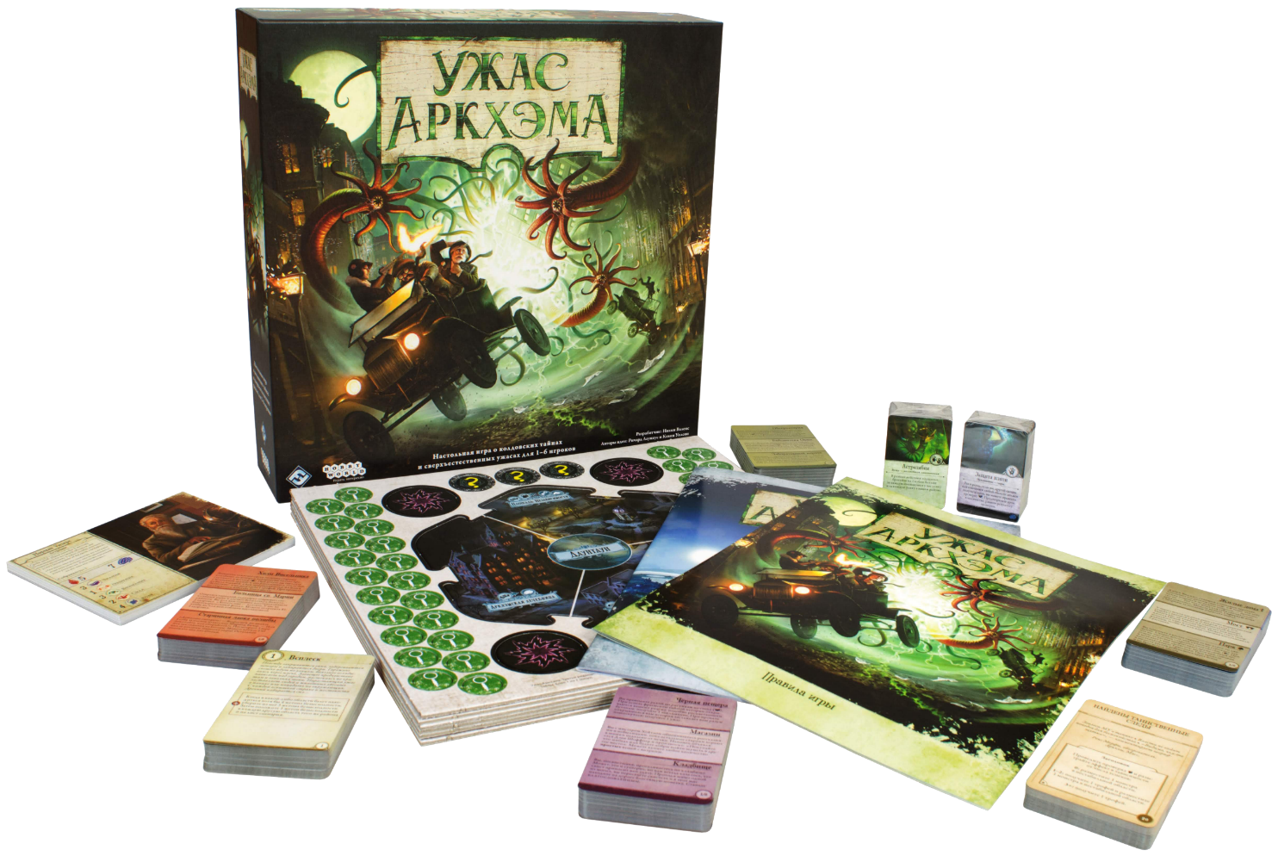
HOBBY WORLD
For around 20 years we have been localizing games for the Russian market. In our portfolio we have only the best games from all over the world. Each year we choose the most interesting releases from the market of board games.
OUR INTERNATIONAL PARTNERS
PUBLISHING HOUSE
ASMODEE, FANTASY FLIGHT GAMES, HABA, KOSMOS, CMON, HASBRO, HANS IM GLÜCK, STEVE JACKSON, CRYPTOZOIC AND MANY OTHERS
WORLD-RENOWNED
ASSORTMENT
BESTSELLERS
OUR PRODUCT PORTFOLIO INCLUDES GAMES FOR ALL AGES AND OF DIFFERENT PRICE RANGE
1. CATAN
2. CARCASSONNE
3. MUNCHKIN
4. TICKET TO RIDE
5. ARKHAM HORROR
6. EXPLODING KITTENS
4

Slide 5
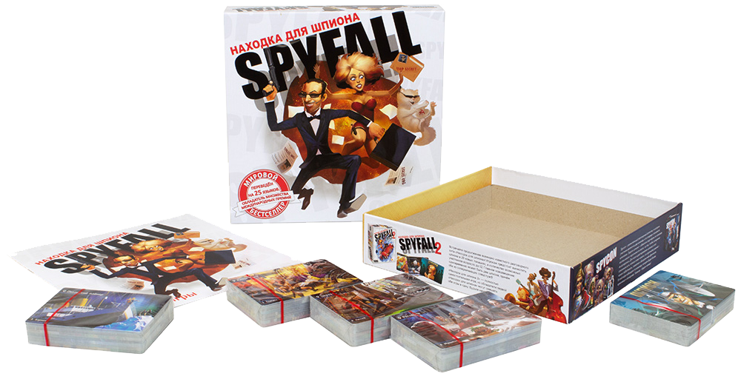
OUR GAMES ARE DISTRIBUTED BY
OUR OWN
Asmodee, Arcane Wonders, CMON, SD Games, Maldito Games, Jelly Jelly Games, Kobold Spielverlag, Midnight Jungle, Rawstone, Piatnik, Jumping Turtle Games, La Boite de Jeu, Cryptozoic, Vagabund, Matagot & Friends, dV Giochi, Meeple Br, Mandoo Games, Don’t Panic Games, Hobby Japan, UltraPro
DEVELOPMENT
SPYFALL
Creating our own product is one of the most important parts of the business. We cooperate with the best Russian and international designers and artists in order to offer an
appealing product to the gaming industry.
Over 100K copies published in 26 languages all over Europe, North America, and Asia
OUR GAMES THAT TURNED INTO INTERNATIONAL HITS
VICEROY
$260 000 gathered on Kickstarter and successfully released in Europe and the United States
1. SPYFALL
2. FURNACE
3. FURNACE: INTERBELLUM
4. DUBIOUS
5. VICEROY
6. MASTER OF ORION
5

Slide 6
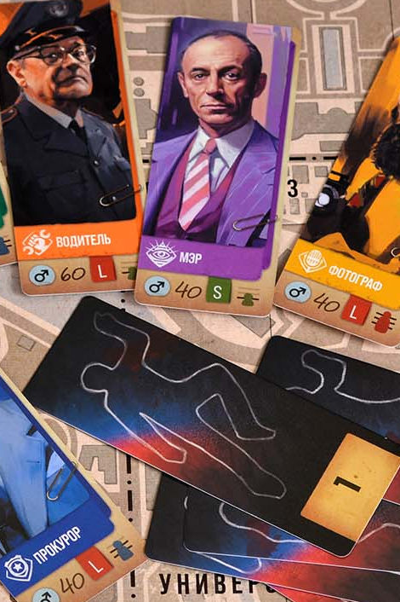
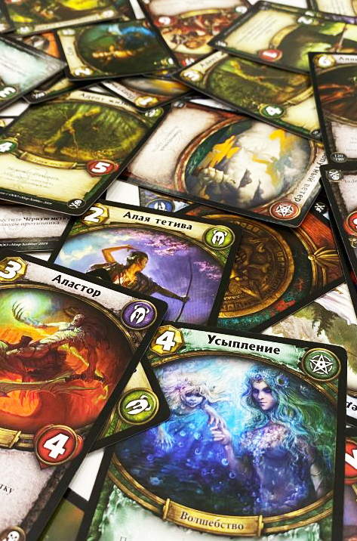
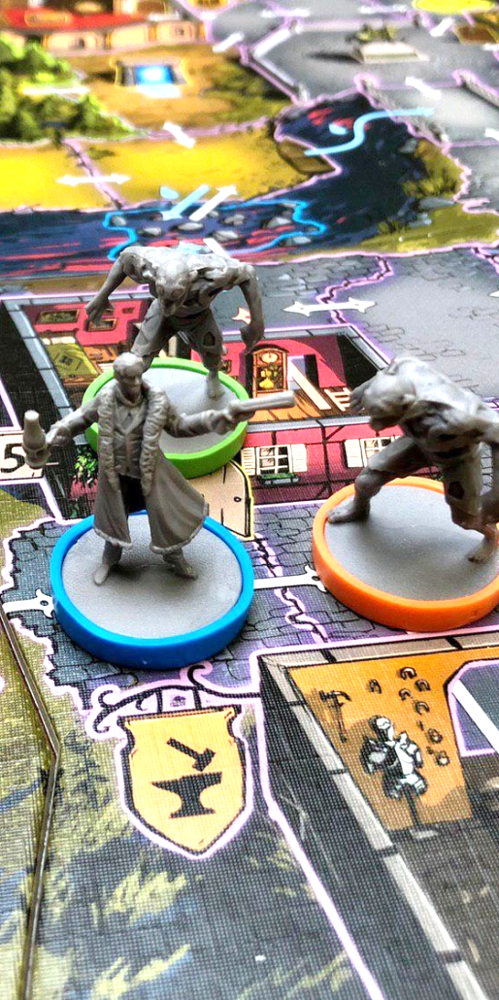
BOARD GAMES
MANUFACTURING
We produce games at our own facilities with a complete production cycle according to the international quality standards
HIGH QUALITY COMPONENTS
AUTOMATED DECK AND BOX
ASSEMBLING LINES
INTERNATIONAL PRINT RUNS
FOR OUR GLOBAL PARTNERS
COMPLETE PRODUCTION
HIGH-QUALITY
PRINTING
COMPLIANCE
CERTIFICATES
95% of the components for our
games are manufactured locally
(in the Moscow and Tver regions),
the rest is provided by our
European suppliers
The publishing group controls
production and final assembling, while
all of the components are
manufactured according to the
international quality standards
All board games are certified
and tested in accordance with
the state requirements
6

Slide 7
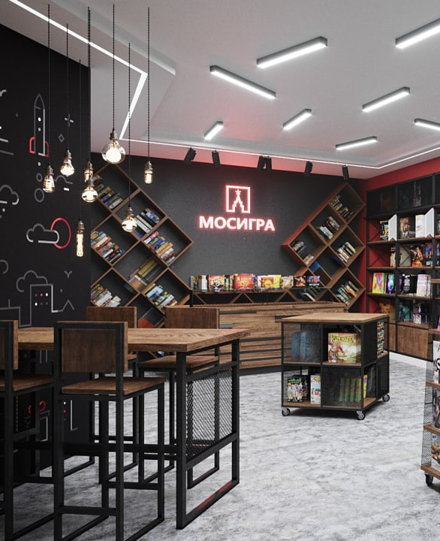
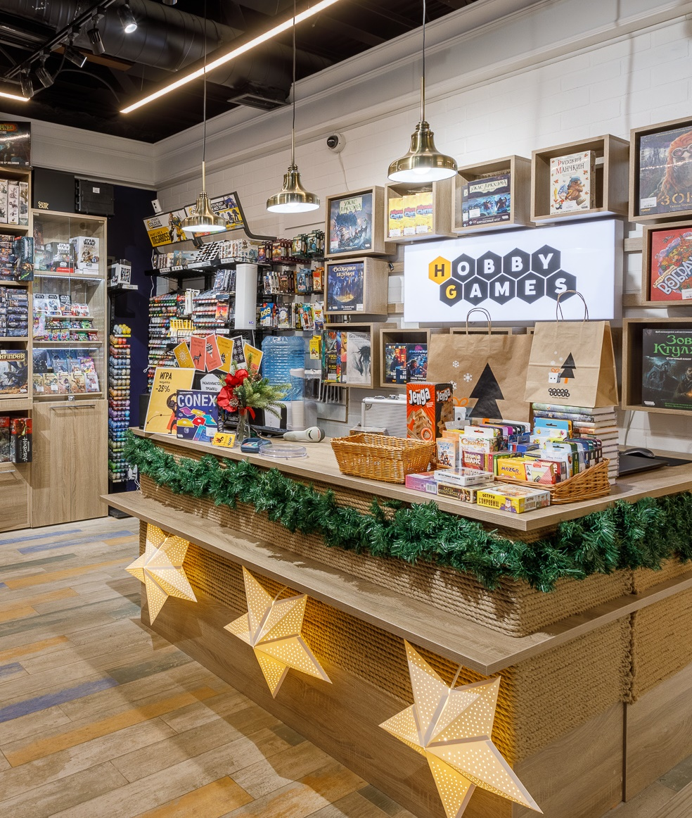

200+ STORES
A retail chain of branded stores with 7000+ products for
casual gamers and hardcore fans of complex roleplaying
games and massive strategies
UNIFIED LOYALTY PROGRAM
Retaining our audience through promotions and a system of accumulating bonuses that can be spent on next purchases
ANY GAMING LEVEL
In our stores, we have a full range of board games:
from children’s games to family and hardcore ones
5 STARS
ONE OF THE LARGEST
More than 10 thousand 5-star rates of our retail chain Hobby Games on the local rating services
SPECIALIZED RETAIL
CHAIN IN THE WORLD
58
BOARD GAMES CLUBS
160+
There are many branded board games clubs all over
Russia that endorse players, provide space to play with
friends and try new games
BRANDED STORES
7
BRANDED STORES
ALL OVER RUSSIA AND CIS
ALL OVER RUSSIA

Slide 8
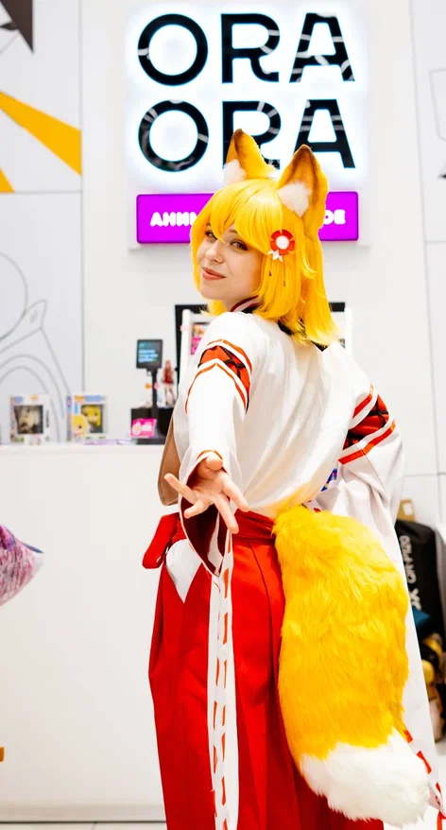
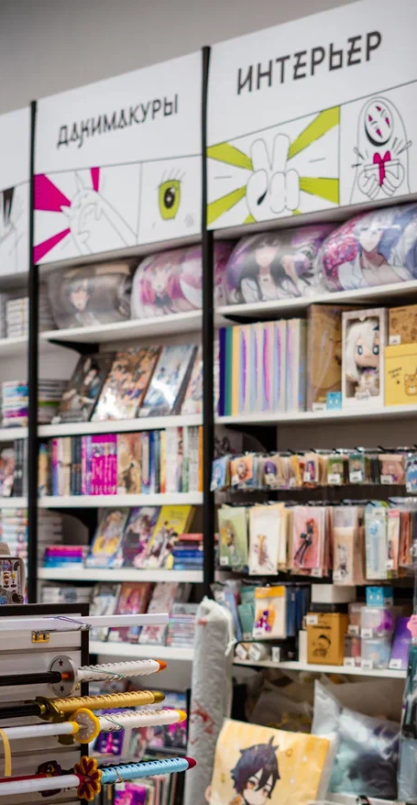
New branch
ANIME STORES ORA ORA
Our aim is to become the center of attraction for the anime & K-pop community in Russia and CIS
December 2023 – July 2024: 3 retail stores
are opened in Moscow
A wide assortment for the Asian culture lovers:
anime, k-pop and other
8

Slide 9
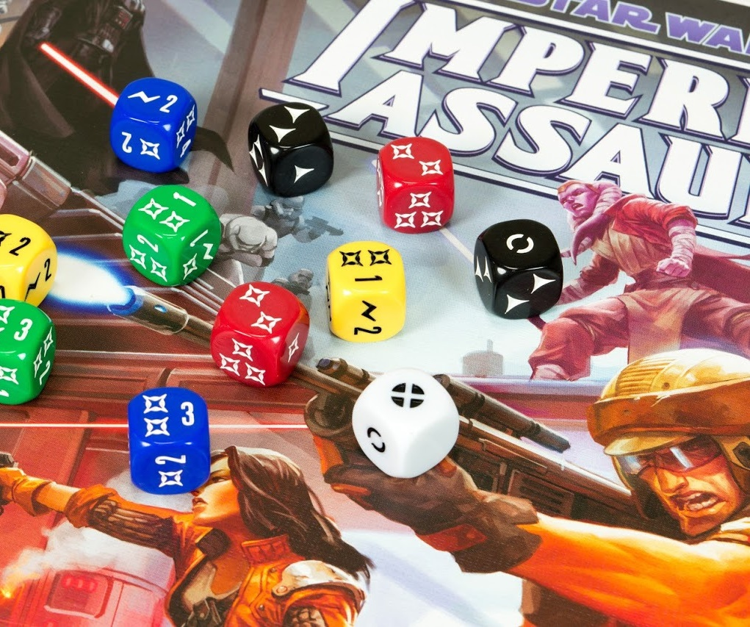



FEEL FREE
TO CONTACT US
Baumanskaya 11/8
Moscow, Russia, 105005
+7 (495) 984-53-83
hobbyworldint.com
info@hobbyworldint.com
9

